Slide 1

At Horsell C of E Junior School we believe that we are all made in the ‘ image of God’. Through a commitment to Christian values and high academic aspirations, we strive to provide a rich and inclusive education for every member of our school family.

Slide 2
Outline of the session
Find out who is in the Year 5 team.
Share the aims and expectations of Year 5.
Key dates.

Slide 3
Meet the Year 5 Team

Slide 4
The Team
Beech Mrs. Mundell
Cedar Mrs Page (Mon – Thurs) Phase leader y5/6
Mrs Hunt – (Friday)
Rowan Miss Cusdin
In addition :
Mrs Hunt, Mr Coles, Mrs Dhina.

Slide 5
How is year 5 different to year 4?
Greater independence and taking responsibility for their learning
Taking on roles with responsibility within school
Being able to voice an opinion eloquently and with reasoning

Slide 6




In year 5 we are aiming to be…
Articulate
Brave
Collaborative

Slide 7
Communication
If you have any worries or queries please feel free to e-mail or phone us about these and we will get back to you. You can also put a note in the HSO for your child to show us.
Medical appointments and absences need to be communicated to the office.
If you email us, we will try our best to reply as soon as possible. This will be within 2 working days.
Please do not leave any concerns until parent’s evening. It is always best to try to sort out any issues with the class teacher in the first instance. If you would like to take a concern further after this, please contact the year leader. Should you have a SEN concern, please contact the class teacher who will liaise with the SENCO.
Letters, including the newsletter, will be issued on a Thursday. You will receive a newsletter every half term from the year group team which will include news specifically related to upper school..
If your child is ill, please phone school or use the Study bugs app, as we will chase up absenteeism on the first morning.
Notes:
Nat

Slide 8
Home - school communication
Home School Organiser (HSO)
Email – staff have 2 working days to respond
Class Teacher - Please always contact your class teacher first with any concerns or queries.
Phase leader
Deputy Head
Assistant Head/Senco (SEN Surgeries book through Mrs. Khan in the Office)
Headteacher (Please do not contact Mrs Wand directly.)

Slide 9
Year 5
Curriculum
English
(Reading, Writing, Spellings and Handwriting)
Maths
Science
History/
Geography
RE
French
PSHE
Music
Art/DT
PE
Computing
Notes:
Nat

Slide 10
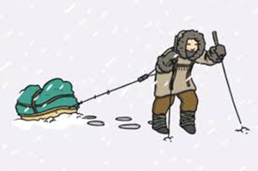

Year 5 Curriculum this term
Maths : place value
+, -, x and ÷ fractions
English : narratives, biographies
Science : properties of materials
History : the life of Henry VIII
Geography : deserts
Art : portraits
DT : Tudor houses
Computing : systems and databases
Detailed information for each subject can be found on the school website.

Slide 11

Reading
In year 5 we will expect your child to read 5 times a week and respond to the question in their HSO. They are expected to record their reading in their HSO and respond to the question in their HSO.
The HSO will need to be signed at the end of each week by an adult.
HSOs will be collected in on a Monday by their class teacher and checked.
As well as reading at home your child will have the opportunity to read with the class teacher on a regular basis both individually and as part of a group or in a pair.
Notes:
Sophie

Slide 12

Maths
In Year 5 we use a range of materials to consolidate the children’s KS2 learning in the lead up to their SATs.
We use White Rose and a base resource to encourage children to deepen their fluency and reasoning skills.
We complete a series of retrieval activities at the start of every lesson to help prepare them for arithmetic style questions.
Maths will be taught in flexible groups, which may change depending on the topic.
Adopting a “mastery” approach i.e. the application to the unfamiliar by applying maths knowledge.
Guiding children to be problem solvers not calculators!
Notes:
Sophie

Slide 13
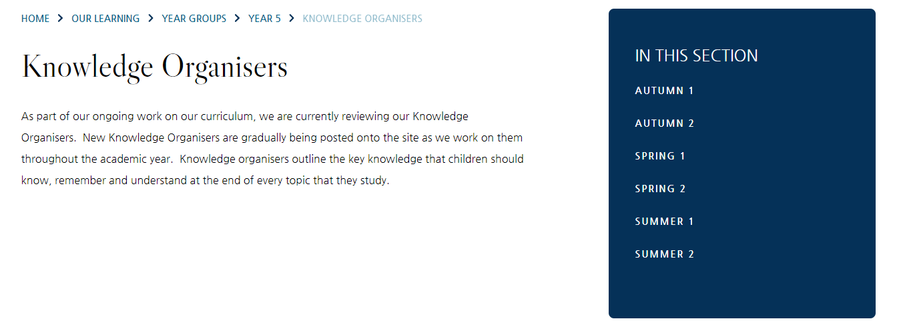

Knowledge Organisers
We use Knowledge Organisers in our curriculum. These will support the children’s core understanding of each topic.
They are available on the school website in the Year 5 area.
We recommend that you access these and use them to help your child’s understanding of each topic.
Copies of these organisers will be put into books for children to refer to in lessons.

Slide 14
Homework
Homework is set on Monday and needs to be completed by the next Monday.
Spellings:
Weekly spellings will be set and written into the children's HSO.
Children will be tested on the spellings the following Monday.
Reading:
Read 5 times a week and record this in your Home School Organiser with a comment about the reading and a reading target activity- to be recorded in the child’s HSO.
SPaG:
The children will bring home a task that reinforces the learning happening in class.
Maths:
Children will take home a maths workbook and will complete the page set by the teacher. This will be linked to the learning happening in class.
If you have any difficulty with completing any of the above tasks, please contact you child's class teacher.

Slide 15
Uniform
We expect all our children to dress smartly and wear the appropriate uniform. Available from Valentinos. See website to purchase online.
School shoes should be black with no visible markings on them.
PE kit and tracksuit. PE Kits should be worn on PE days including swimming .
An old shirt for painting in.

Slide 16
Uniform dress code
No earrings – they must be removed or taped over
No extreme hairstyles; no styling products to be used.
Long hair (touching shoulders) must be tied back and off the face for boys and girls.
Coloured hair accessories must only be in school uniform colours. No flowers or big bows or hard claw clips.
Nail varnish and make up are not allowed.
All lost property is located by reception.
Smart watches (e.g. Fitbits) are not allowed.
Notes:
Becky

Slide 17

Stationery
Please ask at the office if you require a copy of the stationery list. Have spares at home so that things can be replaced overnight.
We provide red, green and purple pens.
Please ensure that writing pens are not biros or gel pens.
Please name everything!
Notes:
Sophie

Slide 18
Fixtures and clubs
We try where possible to hold a range of clubs and book after school fixtures for children to participate in.
When these opportunities arise there are a range of factors that are considered before selecting the children to participate:
Attitude to learning
Behaviour – during all lessons (not just PE), break and lunch times.
Incidents reported on our central monitoring log
If there are repeated incidents, then it will be considered if a child can have the privilege of representing the school during a fixture or attend an after school club session.

Slide 19
How you can help…
Ensuring that you send your child to school with a filled water bottle, coat & HSO each day.
Ensuring that all uniform is correct and labelled.
Reading at home with your children.
Helping your children to learn their times tables and spellings.
Ensuring that your child completes their homework on time.
Making us aware of any issues at home that may affect your child’s learning so we can support them if necessary.
OPAL donations and DIY skills
Notes:
Ammelia

Slide 20
Volunteers
If you are able to volunteer some time to help in school, please contact your class teacher.
Ideally we would love some help with hearing children read, times tables and helping with cookery sessions.
We will help arrange your DBS check too.

Slide 21
Money Matters
As much as we can, we book our school trips a year in advance. A payment schedule is set up so that parents can pay in monthly instalments to help spread the cost. Parents in receipt of pupil premium funding get support with these costs.
Parents are also asked to contribute towards swimming lessons. Children receive a term’s swimming lessons every year. For 2026-2027, the cost will be £30.
Year 5 overnight trip to Winchester Science Museum ; approx. £65.
Notes:
Ammelia

Slide 22
Pupil Premium & Free School Meals
Additional academic monitoring and support as needed.
Fantastic enrichment opportunities and resources in school (author visits, new reading texts, digital equipment).
Trips and workshops paid for, plus up to 50% contribution towards residential trips.
New this year – 15% of the PP is available to you to put towards extra curricular clubs at school, or music lessons. This is £222 this academic year.
Some families are eligible for Free School meals as well as Pupil Premium funding.
If you feel you may be eligible, please speak with the Office to complete the forms, or access them via the school website.

Slide 23
SEN
If you have concerns, or with to discuss something, speak with class teachers in the first instance. They know your child best in school.
Following that, SEND Surgery – Tuesday mornings (book through Mrs Khan – Office).

Slide 24
Dates
6th Oct : Harvest festival 9:30am
Spring term : Woking mosque (tbc)
24th -25th June : Sleepover Winchester Science museum.

Slide 25
Any questions?
Contact us at…
j.page@horsell-junior.surrey.sch.uk
c.mundell@horsell-junior.surrey.sch.uk
k.cusdin@horsell-junior.surrey.sch.uk
office@horsell-junior.surrey.sch.uk

Slide 26
Thank you for coming
Notes:
Nat

