Slide 1
Relationships and
Sex Education (RSE) and Health Education
At Horsell Junior School

Slide 2
Definition of PSHE
“PSHE is a planned programme of learning opportunities and experiences that help children and young people grow and develop as individuals and as members of families and communities. It helps to equip them with knowledge, understanding and practical skills, appropriate to their age and maturity, in order to live healthy, safe, fulfilled and responsible lives. PSHE also enables children and young people to reflect on and clarify their own values and attitudes, and explore the complex and sometimes conflicting range of values and attitudes they encounter now and in the future. In short, PSHE makes a significant contribution to children and young people’s personal, spiritual, moral, social and cultural development.”
National PSHE CPD Programme, 2015, Babcock 4S & University of Roehampton

Slide 3
DfE
In primary schools, we want the subjects to put in place the key building blocks of healthy, respectful relationships, focusing on family and friendships, in all contexts, including online. This will sit alongside the essential understanding of how to be healthy.
Department for Education – Relationships Education, Relationships and Sex Education (RSE) and Health Education Statutory guidance for governing bodies, proprietors, head teachers, principals, senior leadership teams, teachers

Slide 4
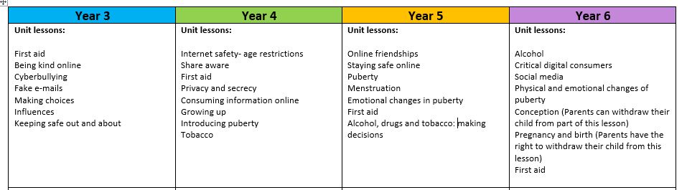
The Overview
Videos to support this are shown in year 4, 5 and 6

Slide 5
The lesson
Ground rules will be set.
The correct scientific vocabulary will be shared and the children will be encouraged to use this.
Boys and girls will be separated into different groups for some of the teaching.
Opportunities for questions and clarification- written or spoken

Slide 6
The videos
Year 4 – Introduction into puberty
Year 5 – Puberty
Menstruation
Year 6 – Puberty recap ( same as year 5)
Menstruation recap ( same as year 5)
*Conception
*Pregnancy and birth
*Parents can choose to withdraw their child from Conception and Pregnancy and birth lessons , however, the Department for Education (DfE) recommends that children understand how a baby is conceived and born before starting secondary school. )

Slide 7

Any questions

