Slide 1


HORSELL SCHOOLS’ PTA
ANNUAL GENERAL MEETING
2024/2025
24th September 2025 - Horsell Village School

Slide 2

AGENDA
Ratification of new Secretary
Reflecting on the previous year – Emma Machin & Sima Huddy
Treasury Overview – Emma Machin
Horsell Village School - Mrs Reeve
Horsell Junior School - Mrs Wand
Looking ahead – Sima Huddy
Q&A

Slide 3

RATIFICATION OF NEW SECRETARY
Position
Horsell School PTA Secretary - Charity Registration No: 1094182
Background
Candidate Name: Beverley-May Collins
Approval
PTA Committee has reviewed the proposed candidate and unanimously approves Beverley-May Collins for the position of PTA Secretary.
Resolution
Resolution passed here to formally confirm the appointment.

Slide 4
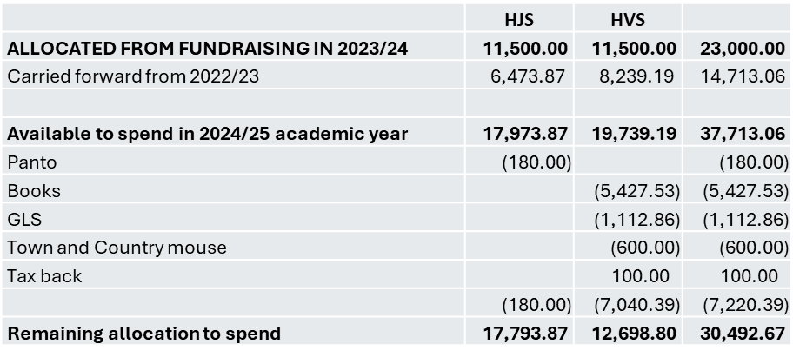
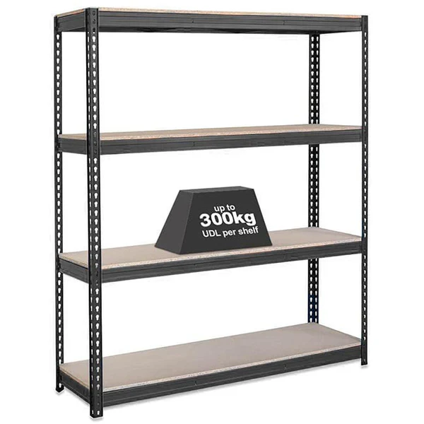
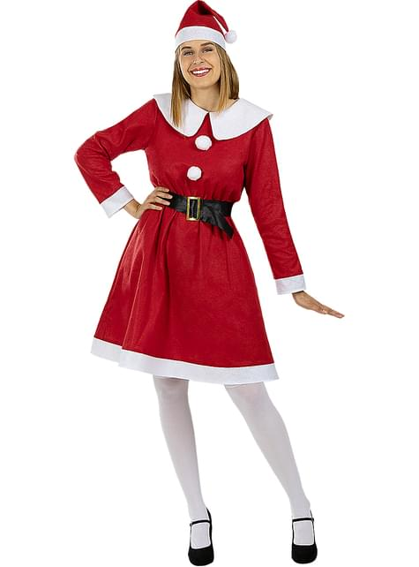
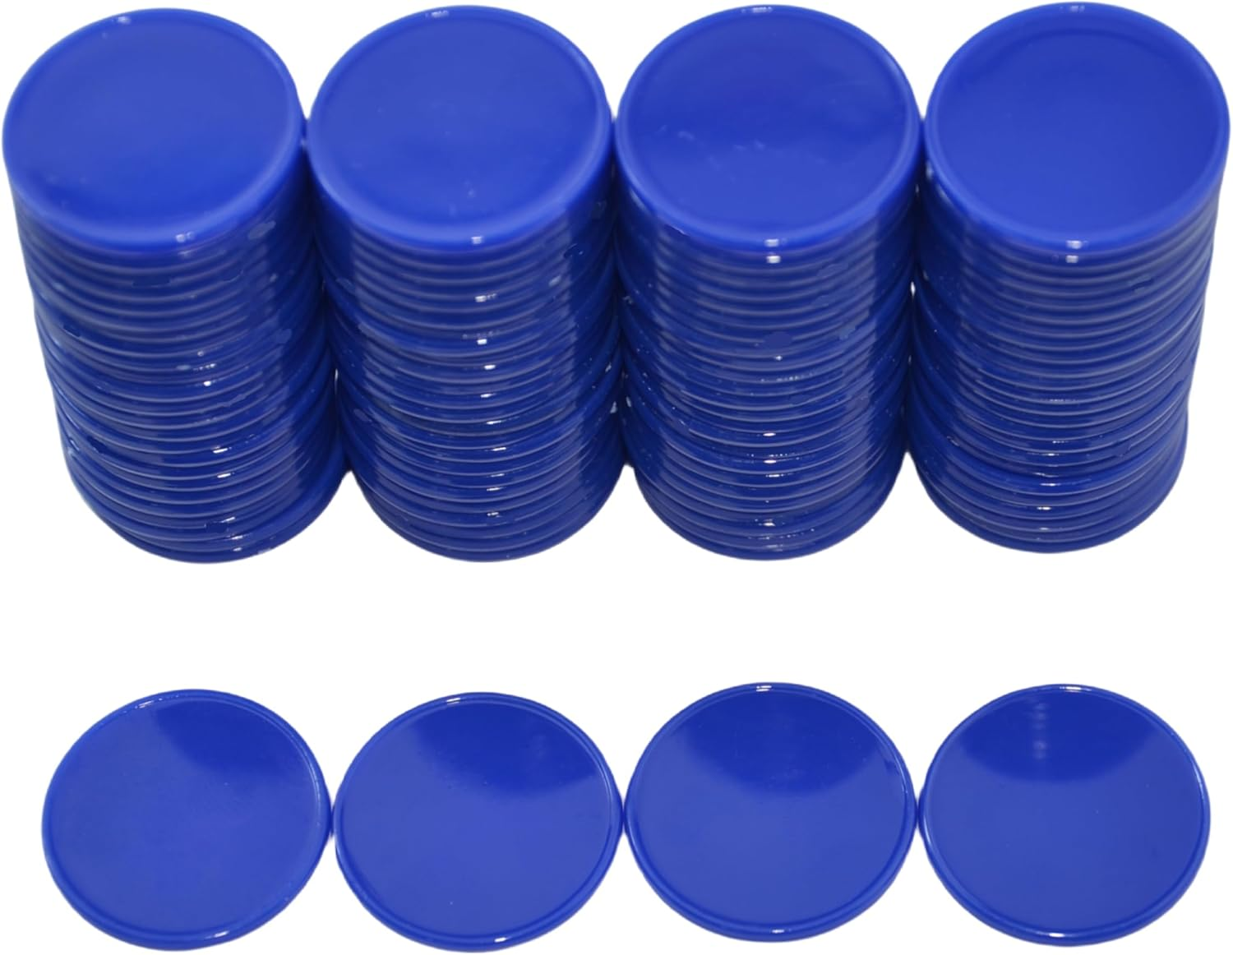
REFLECTING ON PREVIOUS YEAR – PTA OVERVIEW
*Reminder* at 23/24 AGM, PTA reported £37k for schools to spend.
(£14k carried over from previous years + £23k new income.)

Slide 5


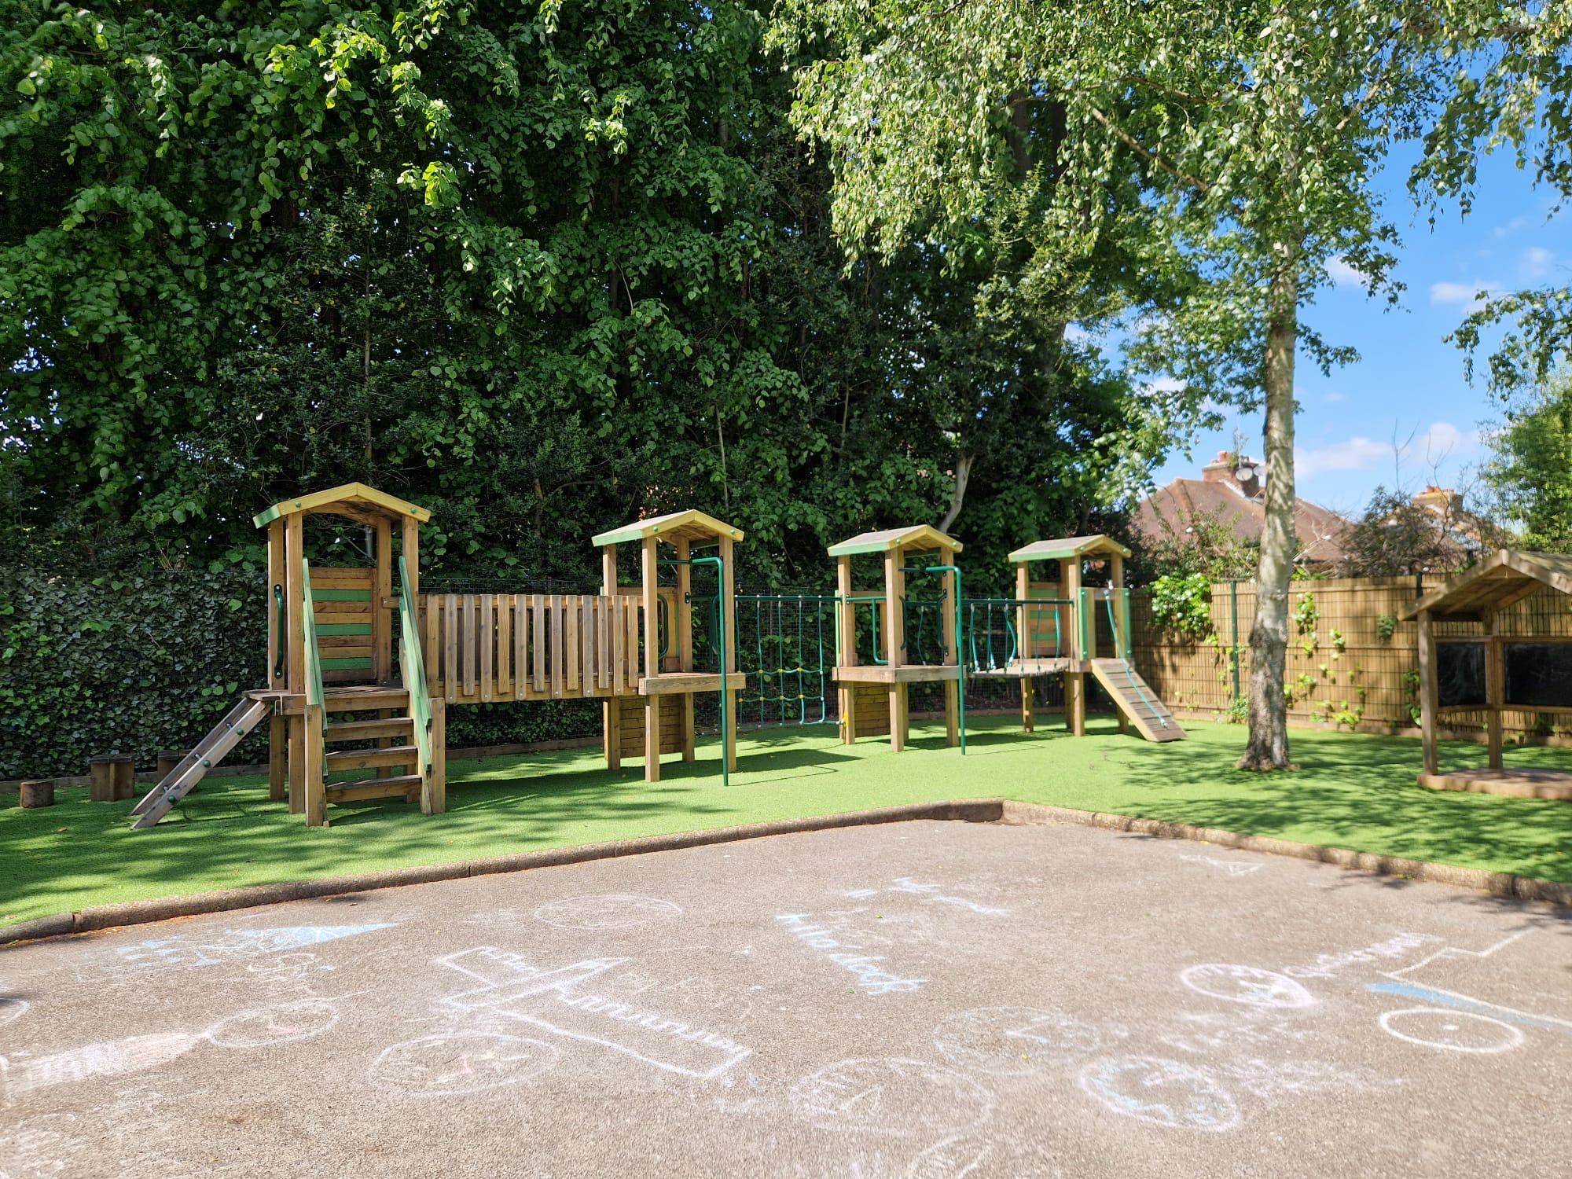

REFLECTING ON PREVIOUS YEAR – HVS & HJS
Horsell Village School:
Guided reading books
Outside learning resources
Visualisers for the classrooms
Christmas pantomime
Horsell Junior School:
New play and outdoor gym area
Christmas pantomime

Slide 6








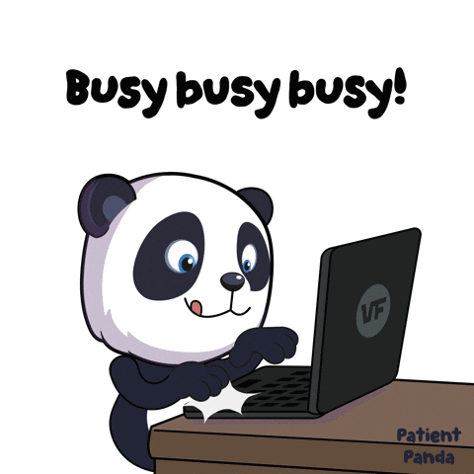
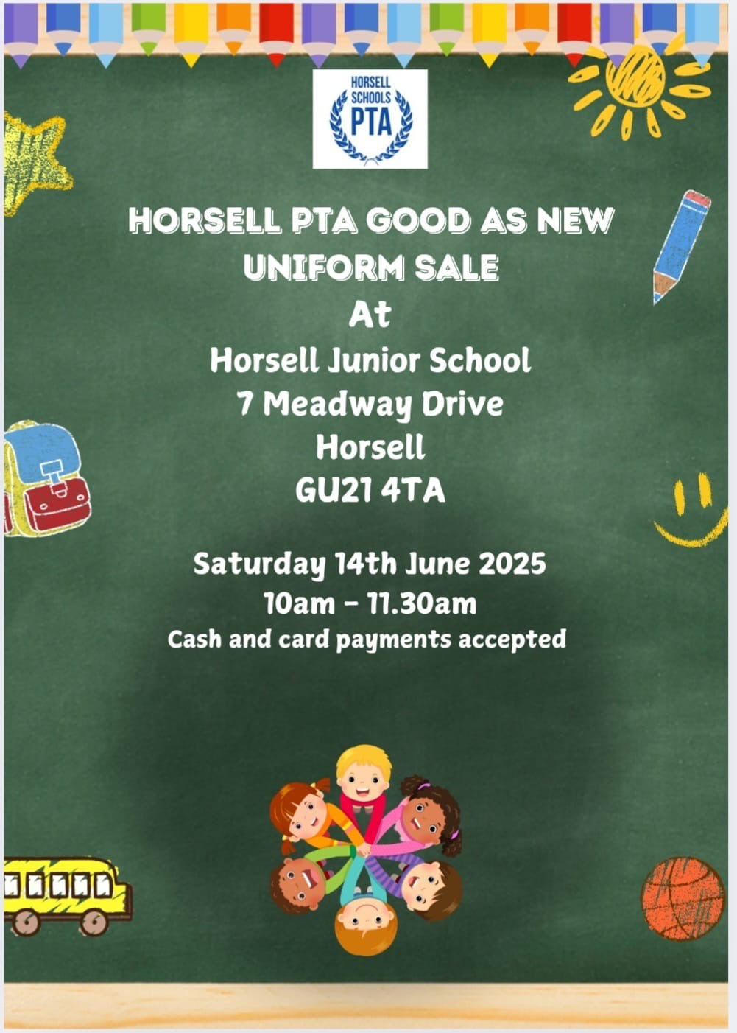


REFLECTING ON PREVIOUS YEAR – FUNDRAISING

Slide 7
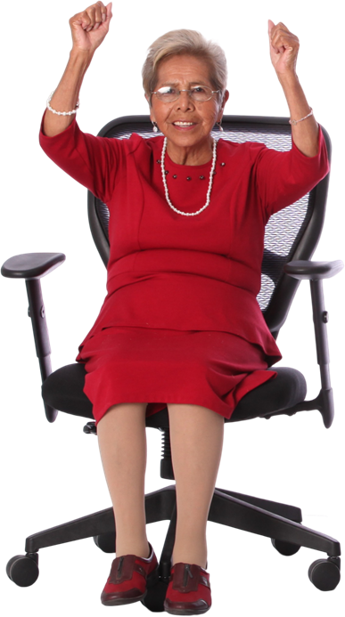

2024/2025 FUNDRAISING TOTAL
£28,396

Slide 8
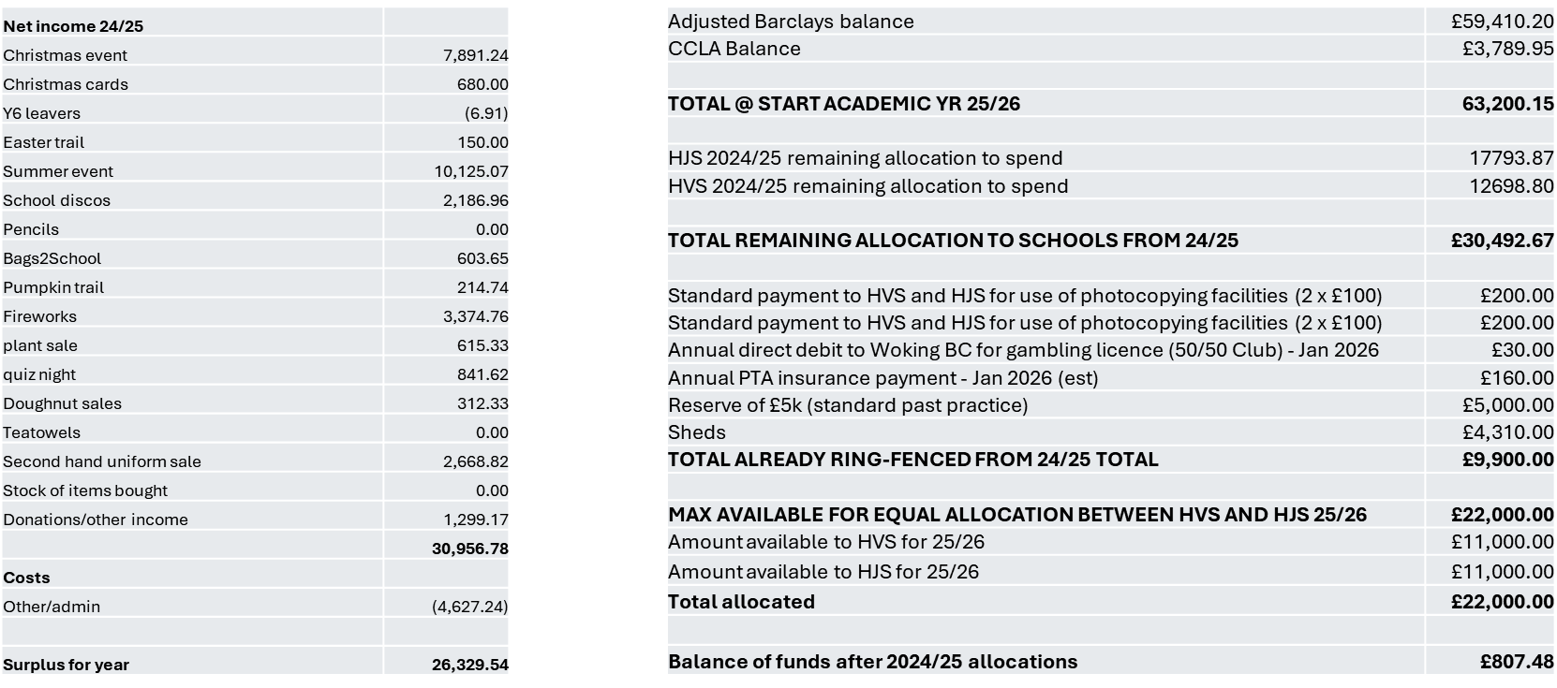
TREASURY OVERVIEW

Slide 9
HORSELL VILLAGE SCHOOL - MRS REEVE
PLANS FOR OUR FUNDS
IT equipment for the classrooms
Organisation walls
World Book Day
Christmas pantomime

Slide 10
HORSELL JUNIOR SCHOOL - MRS WAND
PLANS FOR OUR FUNDS
New easy to assemble stage
More Chromebooks
Christmas Pantomime
Outdoor Play Area

Slide 11

HOW CAN YOU HELP?
Run social or fundraising events
Volunteer at events help event teams in the run up to events
Attend events, buy raffles tickets, spread the word
Donate your service for raffle prizes
Become part of the steering group
Current Vacancies: Contact your Class Rep or the PTA on horsellschoolspta@gmail.com
Deputy Chair
Deputy Treasurer

Slide 12

KEY DATES FOR YOUR DIARY
OCT 2025
Fri 3rd - Cauliflower Cards (deadline)
Fri 10th - Crazy Hair day
*No Fireworks event this year due to no one to run it.*
NOV 2025
TBC - Little Recyclers
Fri 20th Nov - School Disco (HJS only)
Fri 21st - Mufti donations
DEC 2025
Sat 6th - Christmas Fair
*please sign up to help when the sign up links go live
JAN 2026
Sat 17th Good as new Uniform sale
FEB 2026
MAR 2026
Fri 6th – Bingo night
Fri20th to Fri 27th – Guess the name / how many sweets in a jar
Fri 27th – End of term treat
APR / MAY 2026
TBC - Bags2School
TBC: Plant sale
JUN 2026
Sat 13th Good as new Uniform sale
Fri 19th - Mufti day
JUL 2026
Sat 5th Summer Fair
TBC - End of year Disco (HJS only)
Tue 17th - End of Term treat

Slide 13
QUESTION & ANSWER
Q&A
THANK YOU

