Slide 1

Welcome!
Information evening for new Year 3 parents

Slide 2
At Horsell C of E Junior School we believe that we are all made in the ‘ image of God’. Through a commitment to Christian values and high academic aspirations, we strive to provide a rich and inclusive education for every member of our school family.

Slide 3
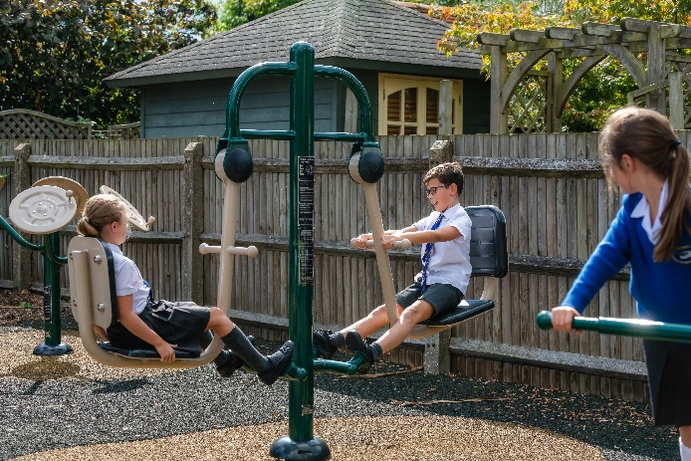

Christian values
Dignity
Hope
Justice
Service
Love
Forgiveness

Slide 4
Outline of the session
Our vision
Important names and members of staff
What is different about a church school
Our curriculum
Practical matters

Slide 5
Our vision for our school..
We place equal weight on a child’s academic success and their pastoral needs.
What does this look like?

Slide 6
Important names and adults within the school
Mrs Wand – Headteacher
Mrs Brinicombe – Deputy Headteacher
Ms Ash – Assistant Head with responsibility for Inclusion, SEND and Safeguarding
Mr Dunsford – Head of Year 3, Class teacher (Oak)
Miss Harrington – Class teacher (Ash)
Ms Nash – Class teacher (Elm)

Slide 7

Horsell Junior School is a church school..
We are a church school which means that we have a session of Collective Worship every day from 8 55 – 9 10. The whole school attends.
As a church school RE is a CORE subject, which means that it is taught for 1 hour every week. The content of the RE syllabus is set by the diocese and is therefore predominately Christian. We do cover all of the major world faiths in RE and encourage the children to compare the different religions where we can.
We celebrate the key religious festivals of all of our pupils.
We have strong links with our local church.
I came to give life—life in all its fullness John 10:10

Slide 8
We are a Voluntary Aided School
The Governors at our school are the employer – not the county council
The constitution of our Governing body has to represent the religious character of our school. (‘Foundation’ governors)
The Diocese owns the building and we have to make up 10% of capital projects, hence the Governors’ Fund
In addition to OFSTED, we have a SIAMS inspection, which looks at the ethos and vision of our school, and also assesses how well we care for our children pastorally and spiritually. This is additional reassurance for parents regarding the quality of education and care at our school.

Slide 9
How is Junior School different?
Your child is becoming more independent – they are growing up!
They will be encouraged to take more responsibility for their equipment, homework and behaviour
Information is shared via email and the website – but we do encourage the children to tell you important information as well
Teaching Assistants work across the school and are not assigned to particular classes, although children with an Education, Health and Care Plan will have a TA who works closely with them

Slide 10
How is Junior School different?
Junior school is usually the time when children start to become more socially aware, which can lead to more playground disagreements and friendship worries. This is completely normal.

Slide 11
How do we help the children become more independent and resilient?
‘What could YOU do?’
PSHE
Zones of Regulation
Named adult
Use our values to help the children reflect on their behaviour choices and use a restorative approach to encourage empathy, forgiveness and understanding
Expectations around PE kits and remembering important pieces of equipment
Home school agreement
We also mix up the classes at the end of every year so that they get used to socialising with more children and develop a wider friendship circle.

Slide 12
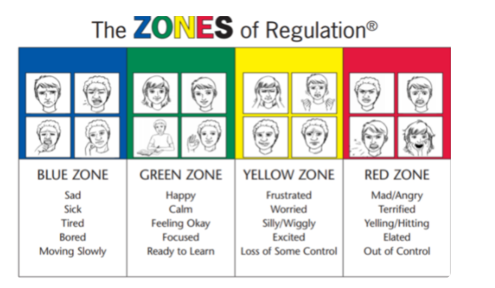
What can parents do to support their child?
What could YOU do?
Use the language of ‘zones of regulation’

Slide 13
We cover the national curriculum..
Our Curriculum Vision ('intent')
At Horsell C of E Junior School we provide a ‘rich and inclusive education’. We believe that we all have unique, ‘God-given’ gifts that must be nurtured to their full potential in a broad and exciting curriculum.
The Horsell Curriculum, through an engagement with the works of great thinkers, athletes,
artists, writers, musicians and scientists, aims to challenge and inspire its children to become
enquirers, risk takers, collaborators, problem solvers and compassionate guardians of the world
in which they live.
What does this look like in the classroom?
1. School values (dignity, hope, justice, service, love and forgiveness) are threaded through curriculum and planning choices
2. Inspiring literature used as a stimulus for learning across the curriculum
3. The use of high quality resources, to invoke awe, wonder, fun and enjoyment
4. An emphasis on both our local and global environment
5. Well-prepared, carefully considered lessons with strong subject knowledge at the
forefront

Slide 14


Maths, Reading and Writing
We use ‘Maths No Problem’ to teach maths

Slide 15

We use the ‘Write Stuff’ to teach writing..

Slide 16
Reading
Phonics will continue for children who need it
We follow ‘no nonsense’ spelling, which follows on from the infant school
Whole class teaching of reading
Children read every day when they come into school in the afternoon
Children experience a class story every day
We have an Amazon wish list where parents can contribute to our school library
Our reading books cover a diverse range of themes
We have a well stocked library and the children can choose their own books

Slide 17

The broader curriculum
Music. We have a variety of visiting instrumental tutors, including violin, piano, drums, guitar, brass, etc. Contact the office if you would like your child to learn an instrument
Forest schools, swimming and cookery (£45 contribution to cover the costs). Children come to school in PE kits on Fridays
The OPAL play project
Sports Clubs: Information about sports clubs goes out at the start of the term and parents should sign up using SCOPAY.
Sports clubs start the 3rd week back after the holidays

Slide 18
Practical information about Year 3 - please check the website for all information
Children are assigned a ‘buddy’ - usually the children meet their buddy when they visit the school but this has not been possible due to COVID restrictions
The school day officially starts at 8 40am, but we open the doors from 8 30am AND we expect children be in school by this time. This is a key time to support the children with additional learning, go over work from the previous day and given them additional time to practise key skills.
School finishes at 3 10pm. Parents should not wait outside the classrooms but should remain in the main part of the playground

Slide 19
School uniform
School uniform can be purchased online or in person from Valentinos,
https://www.valentinoschoolwear.com/

Slide 20
Equipment for the classroom
Reading record
A bag (no large bags as they do not fit on pegs or in lockers). We strongly recommend that all parents purchase the Horsell school rucksack which can be bought from our uniform suppliers
Filled, and named, water bottle
A break time snack (fruit or vegetables only). Please be aware we are a nut free school. No biscuits, sweets or chocolate.
Small pencil case, which contains a ruler, pencil, rubber, pencil sharpener and highlighters.
Purple pen
Children should also bring a pack of colouring pencils, which will remain in school
2 Whiteboard pens (different colours)
Glue stick
Small labelled headphones (for computer work)
P.E. kit in small bag
When the children achieve their pen licence they write in blue, ball point pen.

Slide 21
Homework
Reading Passport: At least 5 times a week for 10 minutes
Reading task
SPAG task
Maths task
We use various online platforms – SEESAW, Mymaths, etc. More information will be sent out in the new term at the ‘Meet the Teacher’ session 10th September at 14: 30pm

Slide 22
Financial Matters
We do not accept cash or cheque at school for trips, uniform or school lunches. All parents will be issued with a unique, secure log on for https://www.scopay.com/ together with instructions on how to use Scopay (Tucasi).
All details of the school trips, dinner money and other payable items will be available on Scopay for you to access online.
School lunches are paid for, and selected in advance, using our online booking system.

Slide 23
Communication: Junior School
Weekly newsletter
Email
Website
What do if you have concerns:
Class teacher
Head of Year (Mr Dunsford)
SENCO (Ms Ash) or Deputy (Mrs Brinicombe)
Headteacher
We aim to respond to emails within two working days. Teachers do not respond to emails during teaching time, after 5 00pm, in the holidays, or at weekends. If the matter is urgent, you should contact the office.

Slide 24
Medical issues
If your child has a medical condition you should complete a medical form which can be found on the website. This should be returned to the office as soon as possible.

Slide 25
What do you do if you want to get involved?
PTA
f you would like to join the PTA Committee, please contact them by E-Mail at horsellschoolspta@gmail.com
The PTA has a dedicated website - please visit http://www.horsellpta.org/
You can also follow the PTA on Facebook at https://www.facebook.com/HorsellPTA/
Parent governor
Opal play project Class Rep
Volunteering in school: Forest school, cookery, reading, times table practice, etc.

Slide 26

Activities over the next few weeks
The children from the Village school will be coming to the Junior School for a session to meet their new class teacher. Unfortunately they will not be able to come inside but we will take them on a tour of the outside of the building.
Our staff are meeting with your child’s current teacher for a handover session
Children joining from other schools will have a tour with a member of staff on 5th July from 9 30am

Slide 27
Planning ahead..
Forward planning is challenging at the minute because we still do not know what schools will ‘look’ like in September.
We do all we can to communicate changes to parents but please be patient as we are often working with last minute changes to government guidance.

Slide 28
We look forward to welcoming you to our school

