Slide 1

Important information for parents for the academic year 2021 - 2022

Slide 2
At Horsell C of E Junior School we believe that we are all made in the ‘ image of God’. Through a commitment to Christian values and high academic aspirations, we strive to provide a rich and inclusive education for every member of our school family.

Slide 3
Outline of the session
To explain some important changes that will be taking place for 2021 – 2022
To give parents the opportunity to ask any questions about these changes- please use the chat function

Slide 4
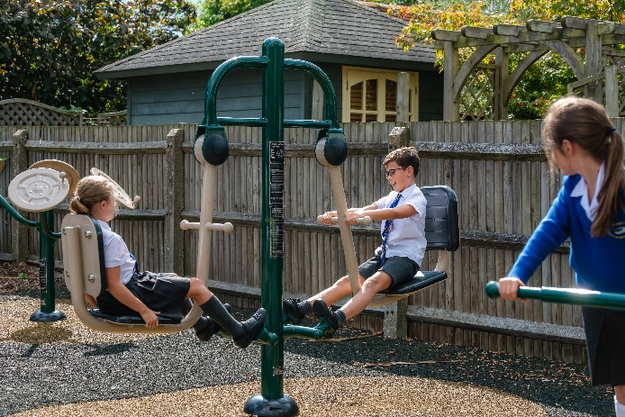

Christian values
Dignity
Hope
Justice
Service
Love
Forgiveness

Slide 5
The context
Global pandemic has had an impact on our children
Academic impact
Social and emotional impact

Slide 6
Academic Impact
‘Gaps’ in learning
Addressed through:
Quality first teaching, booster groups after school and careful use of assessment
Use of external tutoring companies
Changes to how writing is taught, as writing has been most severely impacted over COVID (Jane Considine)
Our children must also experience the full curriculum….

Slide 7
..the wider curriculum..
At Horsell C of E Junior School we provide a ‘rich and inclusive education’. We believe that we all have unique, ‘God-given’ gifts that must be nurtured to their full potential in a broad and exciting curriculum.
The Horsell Curriculum, through an engagement with the works of great thinkers, athletes,artists, writers, musicians and scientists, aims to challenge and inspire its children to become enquirers, risk takers, collaborators, problem solvers and compassionate guardians of the world in which they live.
What does this look like in the classroom?
1. School values (dignity, hope, justice, service, love and forgiveness) are threaded through curriculum and planning choices
2. Inspiring literature used as a stimulus for learning across the curriculum
3. The use of high quality resources, to invoke awe, wonder, fun and enjoyment
4. An emphasis on both our local and global environment
5. Well-prepared, carefully considered lessons with strong subject knowledge at the forefront

Slide 8
Social and Emotional Impact
We have noticed that children are finding it harder to focus in lessons, make positive choices at playtimes, and socialise with their peers, as they have spent a year using electronic devices to communicate
We have increased our emotional support for children (ELSA, Nurture Room, Zones of Regulation, named adults)
We are reviewing our Behaviour policy so it reflects of values of forgiveness and justice.
OPAL play project

Slide 9
Give more opportunities to develop more friendships, develop resilience and be prepared for secondary school

Slide 10
From September 2021 we will be mixing up the classes
Why are we doing this?
Mixing up the classes gives children the opportunity to make new friends, whilst keeping old ones.
It develops resilience as children are exposed to a wider range of friends. It is an effective preparation for secondary school.
4 years is a very long time to be with the same group of people. Whilst some children like this, many need a change. Some children have been together since they started reception in the Village school. There are also some classes in the school that, whilst the children get on very well, are not well balanced for learning and this would be improved with a mix across the year group.
In the past, children were mixed by the Village school when they came up the Juniors. Moving up to Juniors is the one time when we believe the children should not be mixed up so that they settle into a different school, with different routines and expectations, with a familiar group. Children who come from outside the Village school are mixed equally between the different classes. We adopted this approach this year and it worked well.
Mixing has the benefit of much more playing and socialising between the classes. It will very quickly become part of the culture of the school.

Slide 11
How will it work?
Children will be mixed up at the end of Year 3, 4, and at the end of Year 5.
Children have been asked to name 5 close friends. The school will endeavour to place every child with a least one of their named friends.
When mixing the classes, teachers will take into account:
Friendship groups
Gender
Additional educational needs
A mix of abilities

Slide 12
What happens now?
Children have been asked to name friends as part of PSHE
Children will find out their new class and teacher on 12th July
We will tell the children about the new approach on Monday, 21st June so that they can ask us any questions. We will not talk to them about who will be in their classes until 12th July.

Slide 13
How can you help?
This is a new approach at Horsell and some parents - and children - will be understandably anxious.
Please speak positively to your child about the changes, even if you have concerns. Please refrain from using WhatsApp to communicate your worries to other parents, and be assured that teachers and support staff have made decisions based on our thorough knowledge of your child and group dynamics. Remember that children will still be together at break and lunchtimes, and during after-school clubs.
Parents of twins should contact their child’s current class teacher to discuss. Decisions about how to place twins will be made in consultation with parents.
Rest assured that teachers know your child. We are making this change because we believe it is in the best interests of the children at our school.
Most multi-form schools adopt this approach.
We will not seek parental input in the grouping of the children

Slide 14
Results from questionnaires
A few weeks ago, parents were asked about how they felt about mixing up the classes.
Parental feedback was mixed, but the majority were in favour of the proposal. A number were uncertain of how they felt.

Slide 15
Any questions?

